Slide 1
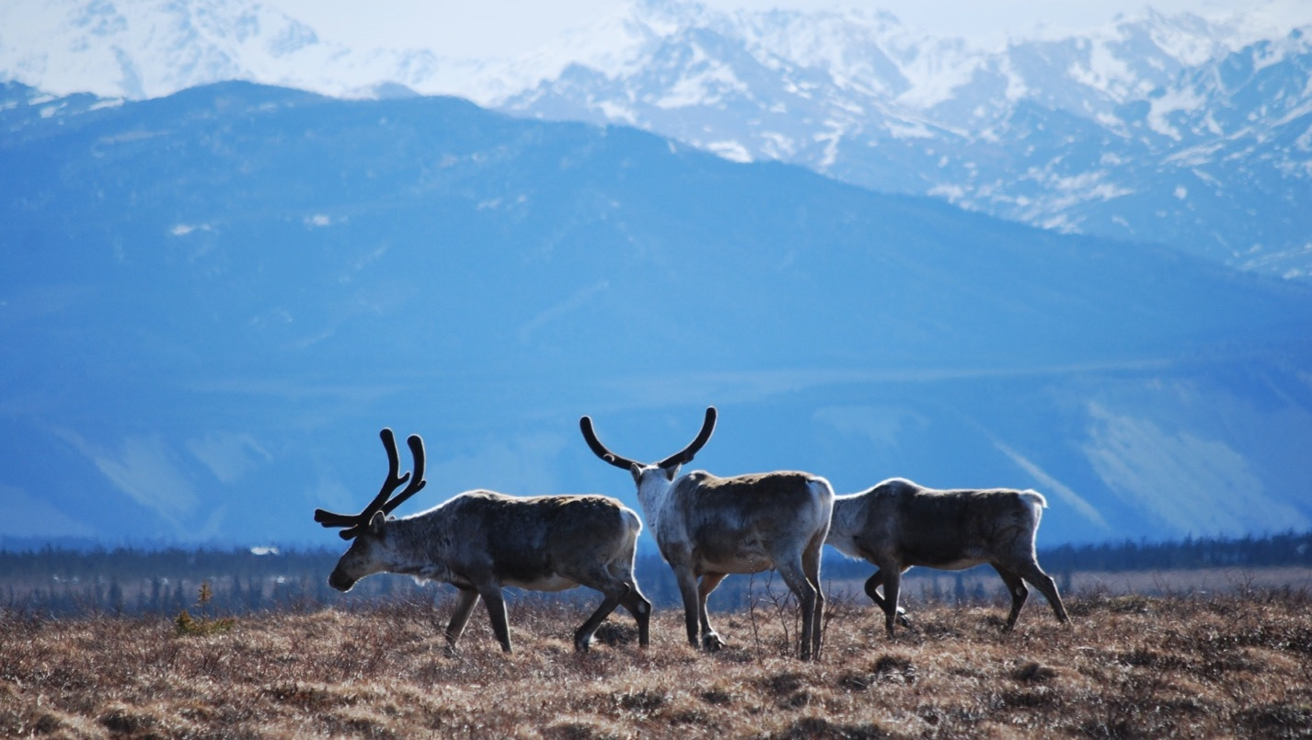
Arctic Boreal Vulnerability Experiment (ABoVE)
2019 ABoVE Airborne Flights
4 August 2022 (DOY 215)
Fairbanks Area #4
Charles Miller, Deputy Science Lead
Jet Propulsion Laboratory, California Institute of Technology
and the ABoVE Science Team For Hank Margolis, Mike Falkowski, Bruce Tagg, Jack Kaye
NASA HQ
2022

Slide 2
4 August 2022 (DOY 215) Fairbanks Area #4
Daily Status:
AVIRIS-NG / Dynamic Aviation B-200 (N53W)
REPORT DATE: 29 July 2022
Current Status of Aircraft: GREEN
Current Status of AVIRIS: GREEN
Current Deployment Location: Fairbanks AK(PAFA)
Crew: W xx(PIC), R Larsen, L Rios, J Chapman, M Helmlinger
Science Planning: A Thorpe
Data Processing: W Olsen-Duvall, J Chapman
Instrument Manager: M Eastwood
Instrument PI: R Green
Science Lead: C Miller

Slide 3
4 August 2022 (DOY 215) Fairbanks Area #4
Daily Summary:
Original target of Mackenzie Mountain lines aborted due to failure to establish communications with Canadian ATC
Rerouted back to Fairbanks area to collect cloud/smoke-free data over key sites
Collected data over both CPCRW and Delta Junction flux towers

Slide 4
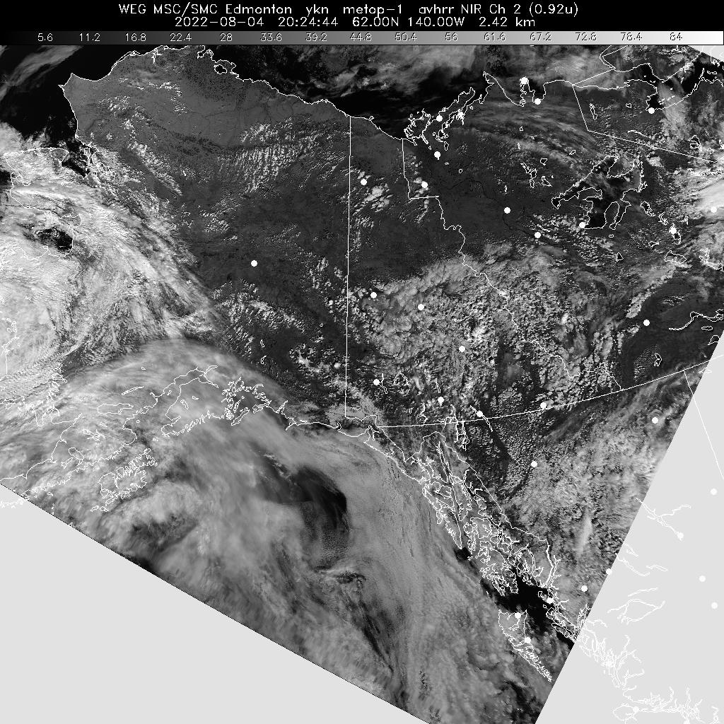
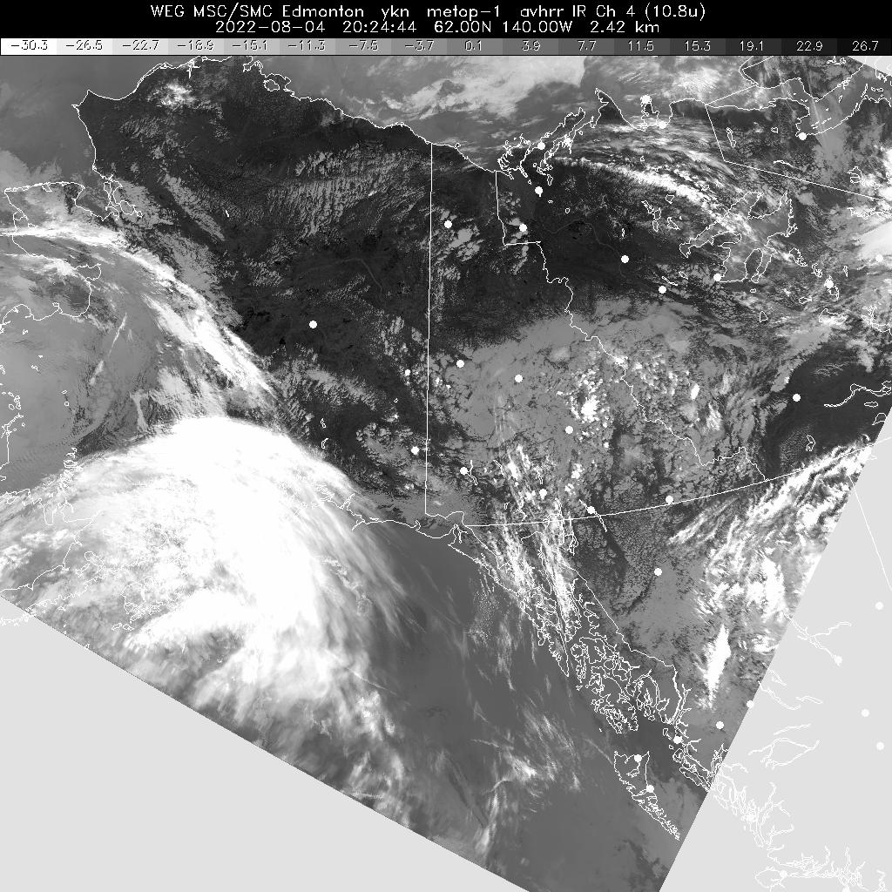
4 August 2022 (DOY 215) Fairbanks Area #4
Notes:
Mostly clear over Fairbanks area, some popcorn clouds

Slide 5
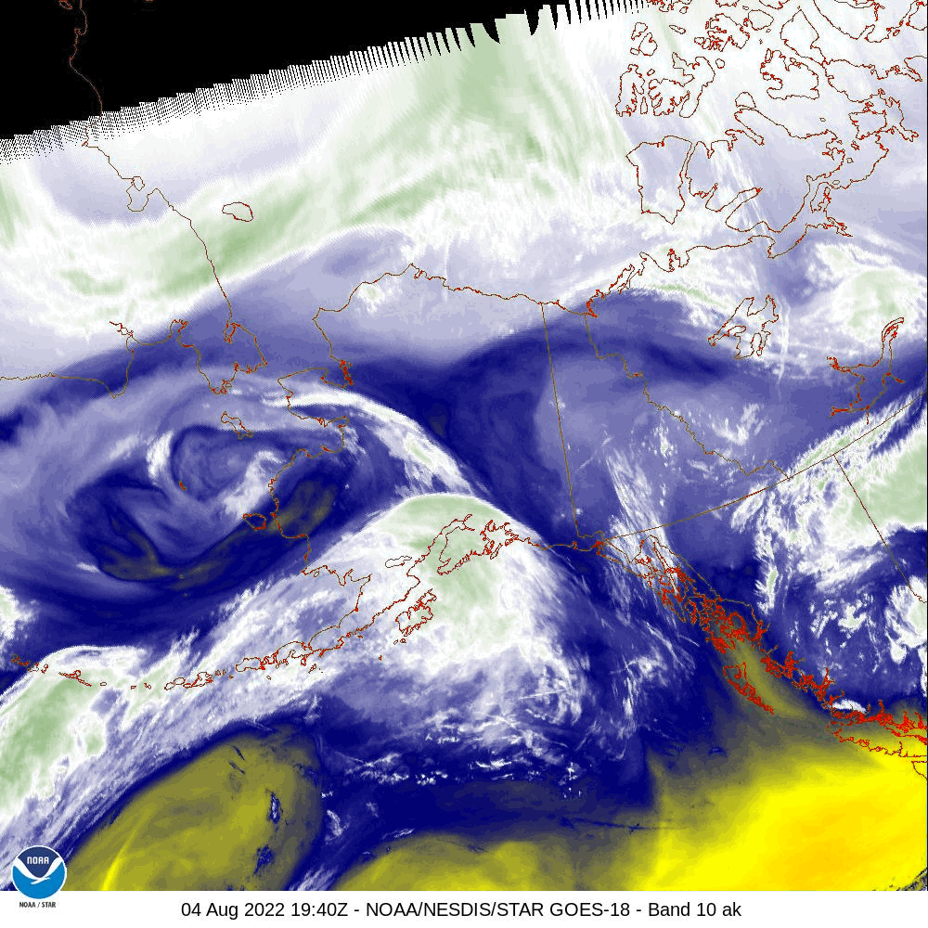
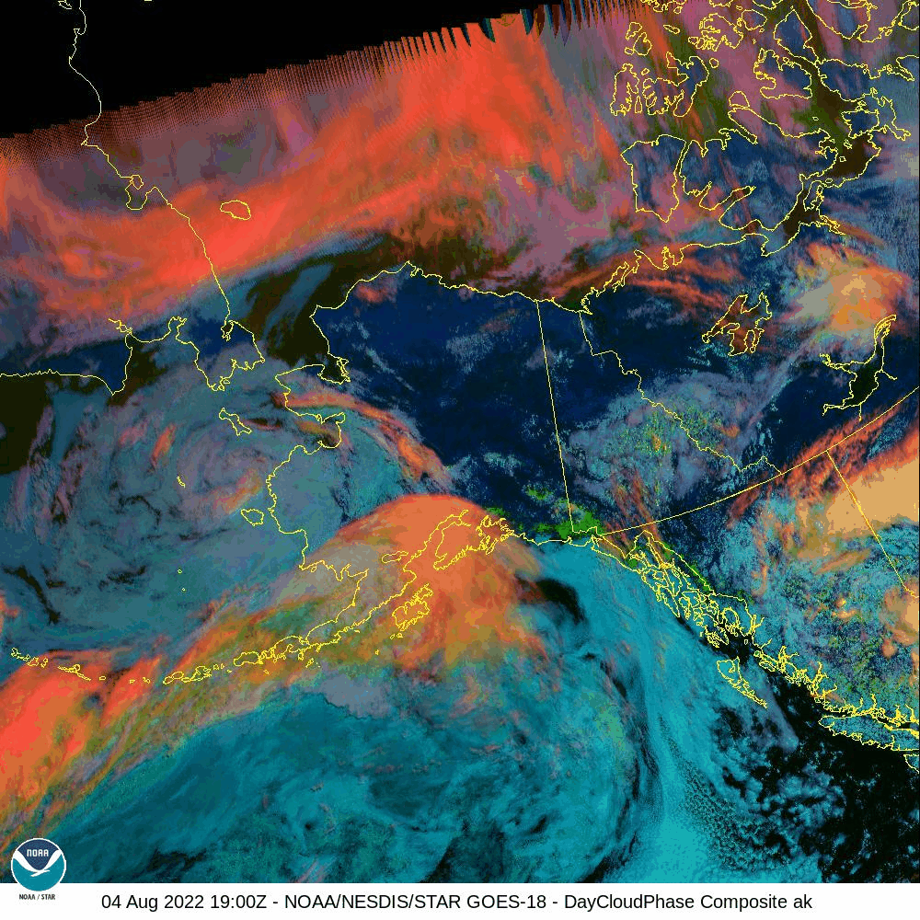
4 August 2022 (DOY 215) Fairbanks Area #4

Slide 6
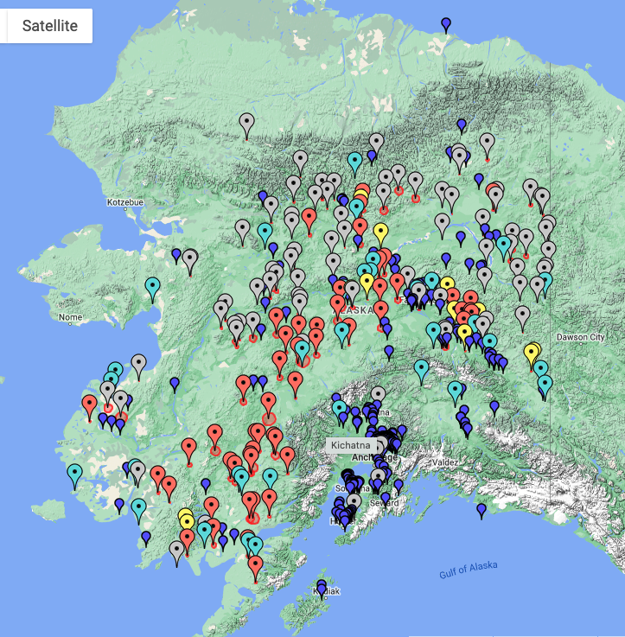
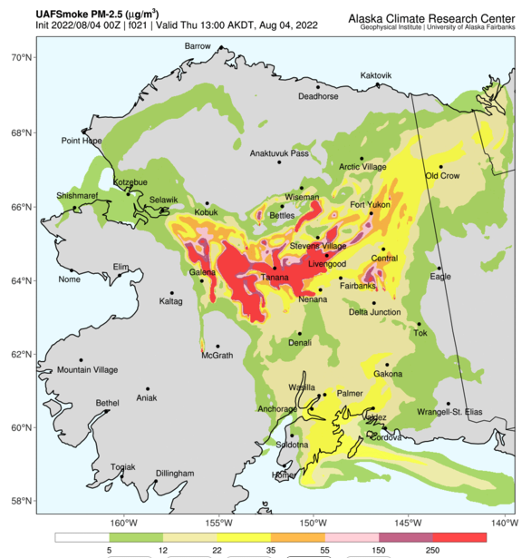
4 August 2022 (DOY 215) Fairbanks Area #4
Notes:
Some areas of patchy smoke around Fairbanks, but generally very low levels compared to early July

Slide 7
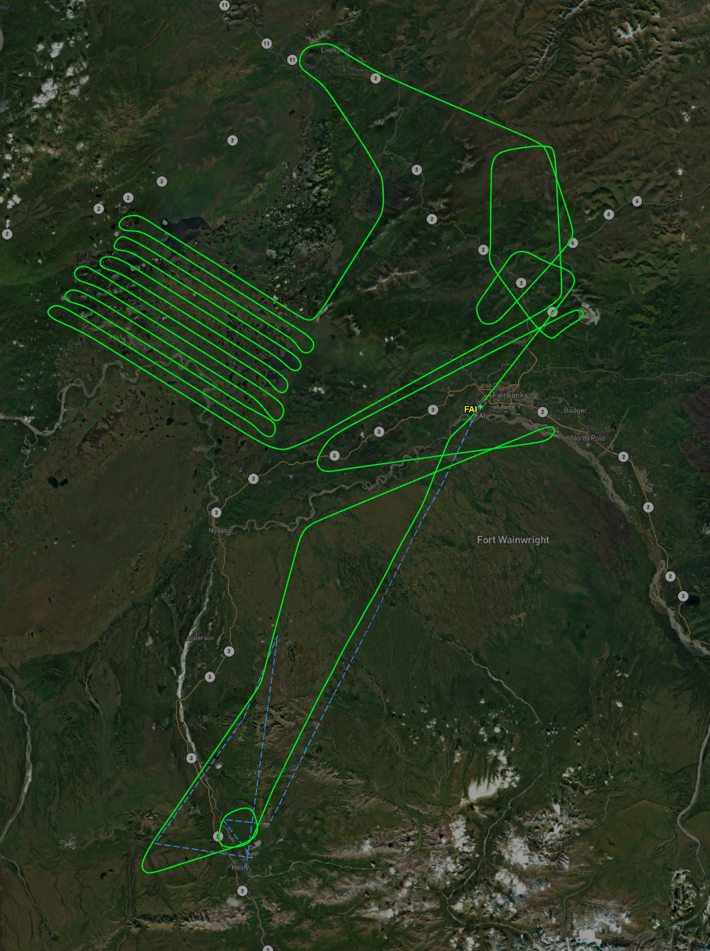
4 August 2022 (DOY 215) Fairbanks Area #4
Flight Plan: All Lines
As Flown Lines
Notes:
Modified flight plan after Mackenzie Mountain lines had to be aborted

Slide 8
4 August 2022 (DOY 215) Fairbanks Area #4
AVIRIS-NG Quick-look products
https://avirisng.jpl.nasa.gov/cgi/flights.cgi?step=view_flightlog&flight_id=ang20220804t
A. Track Air: G-1. LineID: HUN_G001_FL180 , File: ang20220804t194227_raw : 8-Mile Lake/Healy flux tower
B. Track Air: B1-55. LineID: MIL_L019_FL175 , File: ang20220804t200028_raw : BNZ LTER
A
B
Scattered clouds, but mostly usable
Scattered clouds, cloud shadows over CPCRW NEON box

Slide 9
4 August 2022 (DOY 215) Fairbanks Area #4
AVIRIS-NG Quick-look products
https://avirisng.jpl.nasa.gov/cgi/flights.cgi?step=view_flightlog&flight_id=ang20220804t
A. Track Air: B1-54. LineID: MIL_L018_FL175 , File: ang20220804t201001_raw : BNZ LTER
B. Track Air: B2-32. LineID: B10_L004_FL175 , File: ang20220804t202253_raw : Big Trail Lake/Goldstream Valley
A
B
Scattered clouds, but mostly usable
Scattered clouds, cloud shadows over CPCRW NEON box

Slide 10
4 August 2022 (DOY 215) Fairbanks Area #4
AVIRIS-NG Quick-look products
https://avirisng.jpl.nasa.gov/cgi/flights.cgi?step=view_flightlog&flight_id=ang20220804t
A. Track Air: B1-53. LineID: MIL_L017_FL175 , File: ang20220804t203120_raw : BNZ LTER
B. Track Air: B1-27. LineID: HUN_L002_FL180 , File: ang20220804t204025_raw : CPCRW NEON Box, Flux towers
A
B
Open water makes image very dark; scattered sea ice starts about halfway through line
Same

Slide 11
4 August 2022 (DOY 215) Fairbanks Area #4
AVIRIS-NG Quick-look products
https://avirisng.jpl.nasa.gov/cgi/flights.cgi?step=view_flightlog&flight_id=ang20220804t
A. Track Air: B2-8. LineID: B08_L001_FL165 , File: ang20220804t205713_raw : Minto grid
B. Track Air: B2-9. LineID: B08_L002_FL165 , File: ang20220804t210708_raw : Minto grid
A
B
Open water makes image very dark; scattered sea ice starts about halfway through line
Same

Slide 12
4 August 2022 (DOY 215) Fairbanks Area #4
AVIRIS-NG Quick-look products
https://avirisng.jpl.nasa.gov/cgi/flights.cgi?step=view_flightlog&flight_id=ang20220804t
A. Track Air: B2-10. LineID: B08_L003_FL165 , File: ang20220804t211630_raw : Minto grid
B. Track Air: B2-11. LineID: B08_L004_FL165 , File: ang20220804t212550_raw : Minto grid
A
B
Open water makes image very dark; scattered sea ice starts about halfway through line
Same

Slide 13
4 August 2022 (DOY 215) Fairbanks Area #4
AVIRIS-NG Quick-look products
https://avirisng.jpl.nasa.gov/cgi/flights.cgi?step=view_flightlog&flight_id=ang20220804t
A. Track Air: B2-12. LineID: B08_L005_FL165 , File: ang20220804t213517_raw : Minto grid
B. Track Air: B2-13. LineID: B08_L006_FL165 , File: ang20220804t214450_raw : Minto grid
A
B
Open water makes image very dark; scattered sea ice starts about halfway through line
Same

Slide 14
4 August 2022 (DOY 215) Fairbanks Area #4
AVIRIS-NG Quick-look products
https://avirisng.jpl.nasa.gov/cgi/flights.cgi?step=view_flightlog&flight_id=ang20220804t
A. Track Air: B2-14. LineID: B08_L007_FL165 , File: ang20220804t215324_raw : Minto grid
B. Track Air: B2-15. LineID: B08_L008_FL165 , File: ang20220804t220200_raw : Minto grid
A
B
Open water makes image very dark; scattered sea ice starts about halfway through line
Same

Slide 15
4 August 2022 (DOY 215) Fairbanks Area #4
AVIRIS-NG Quick-look products
https://avirisng.jpl.nasa.gov/cgi/flights.cgi?step=view_flightlog&flight_id=ang20220804t
A. Track Air: B2-16. LineID: B08_L009_FL165 , File: ang20220804t221020_raw : Minto grid
B. Track Air: B2-17. LineID: B08_L010_FL165 , File: ang20220804t221832_raw : Minto grid
A
B
Open water makes image very dark; scattered sea ice starts about halfway through line
Same

Slide 16
4 August 2022 (DOY 215) Fairbanks Area #4
AVIRIS-NG Quick-look products
https://avirisng.jpl.nasa.gov/cgi/flights.cgi?step=view_flightlog&flight_id=ang20220804t
A. Track Air: B2-18. LineID: B08_L0011_FL165 , File: ang20220804t222653_raw : Minto grid
B. Track Air: B2-19. LineID: B08_L012_FL165 , File: ang20220804t223528_raw : Minto grid
A
B
Open water makes image very dark; scattered sea ice starts about halfway through line
Same

Slide 17
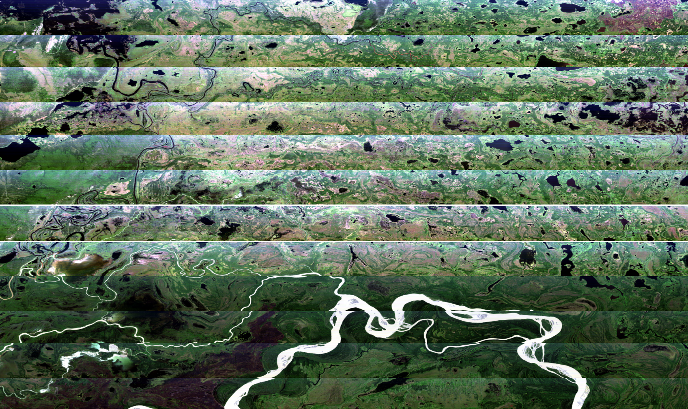

Slide 18
4 August 2022 (DOY 215) Fairbanks Area #4
BACKUP

Slide 20
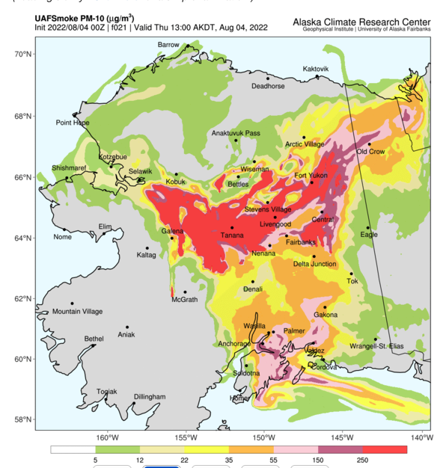
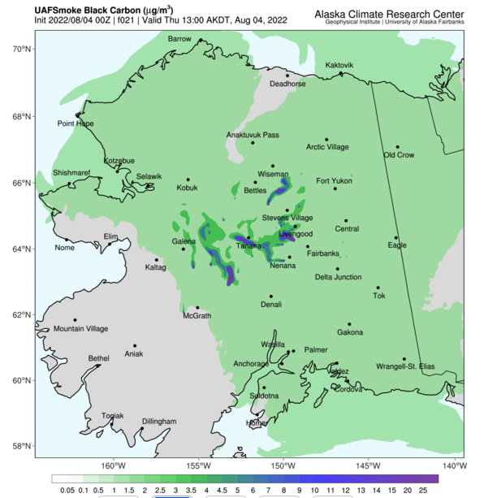
4 August 2022 (DOY 215) Fairbanks Area #4
PM10
BC
Notes:
Moderate PM10 levels around Fairbanks with higher values near Delta Junction

Slide 21
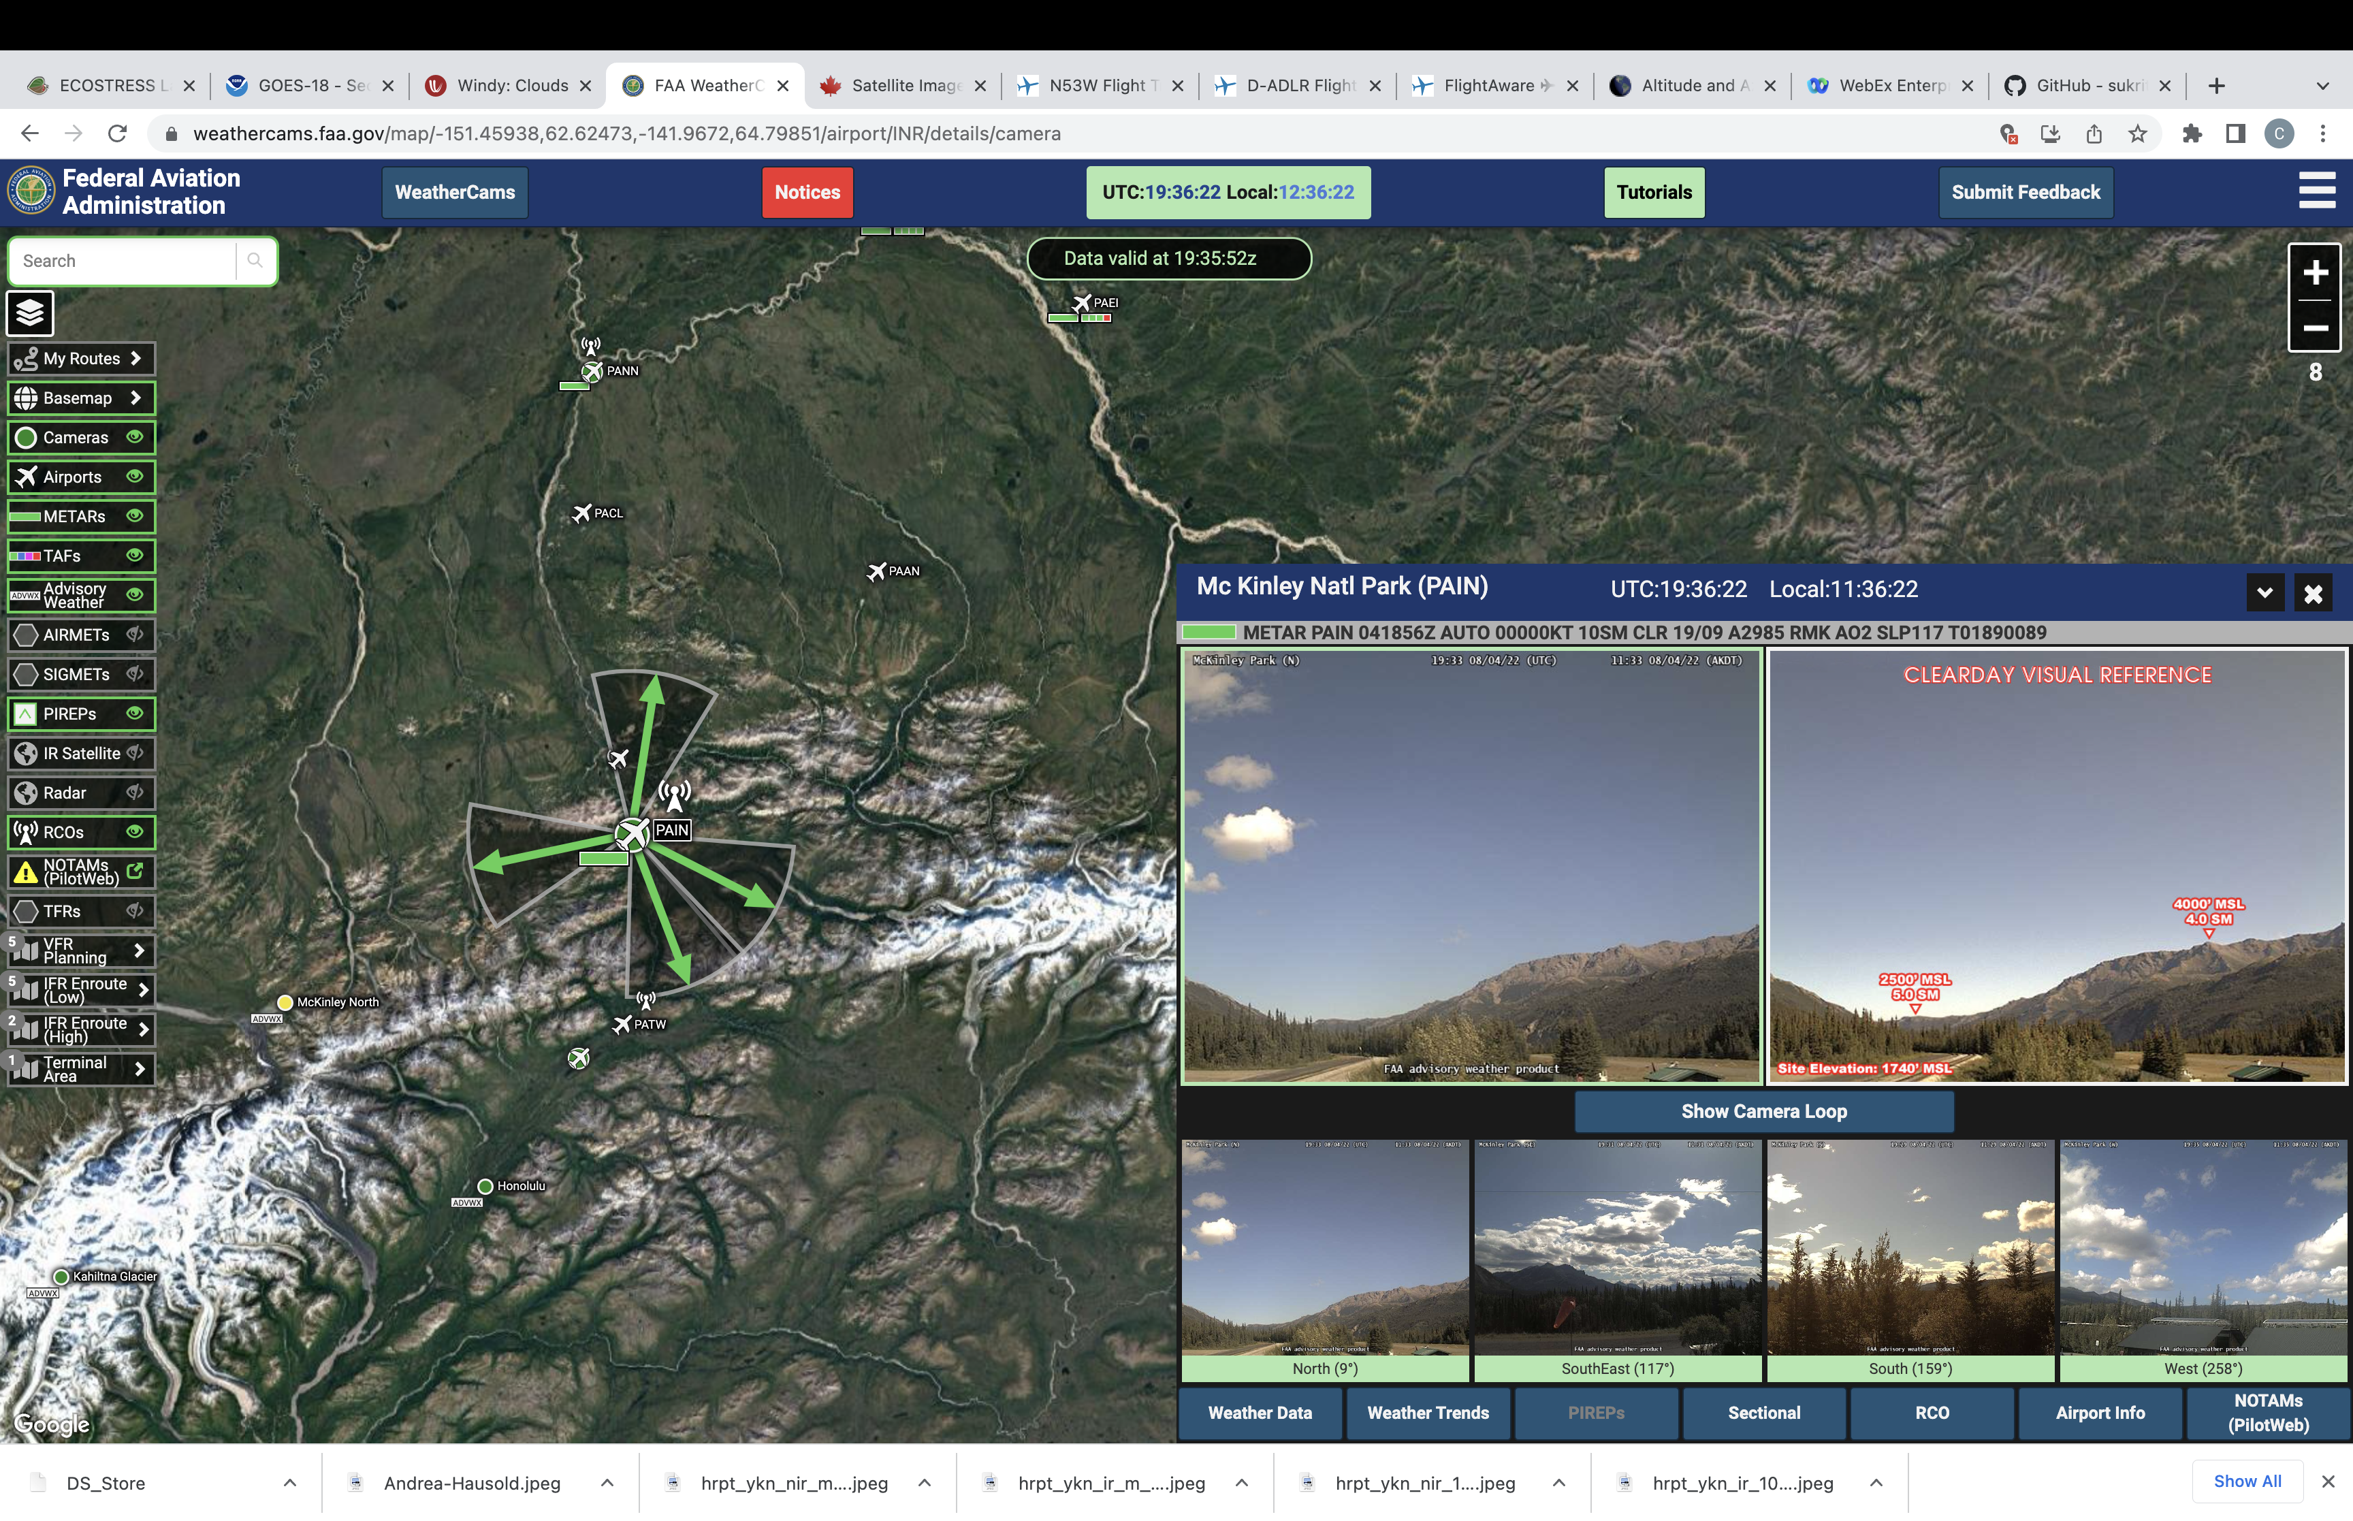
4 August 2022 (DOY 215) Fairbanks Area #4

Slide 22
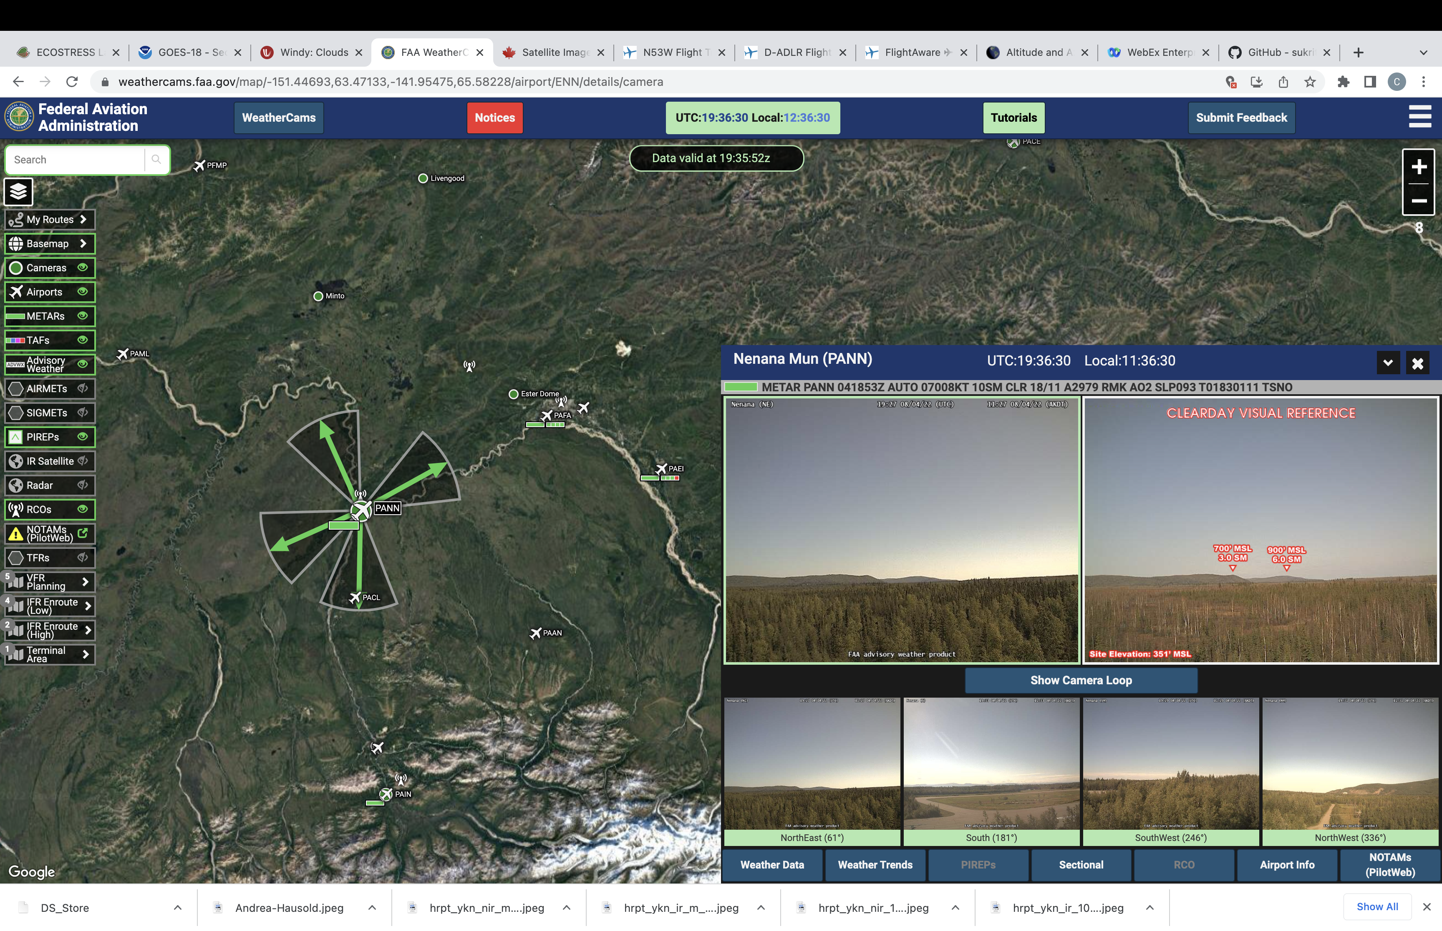
4 August 2022 (DOY 215) Fairbanks Area #4

Slide 23
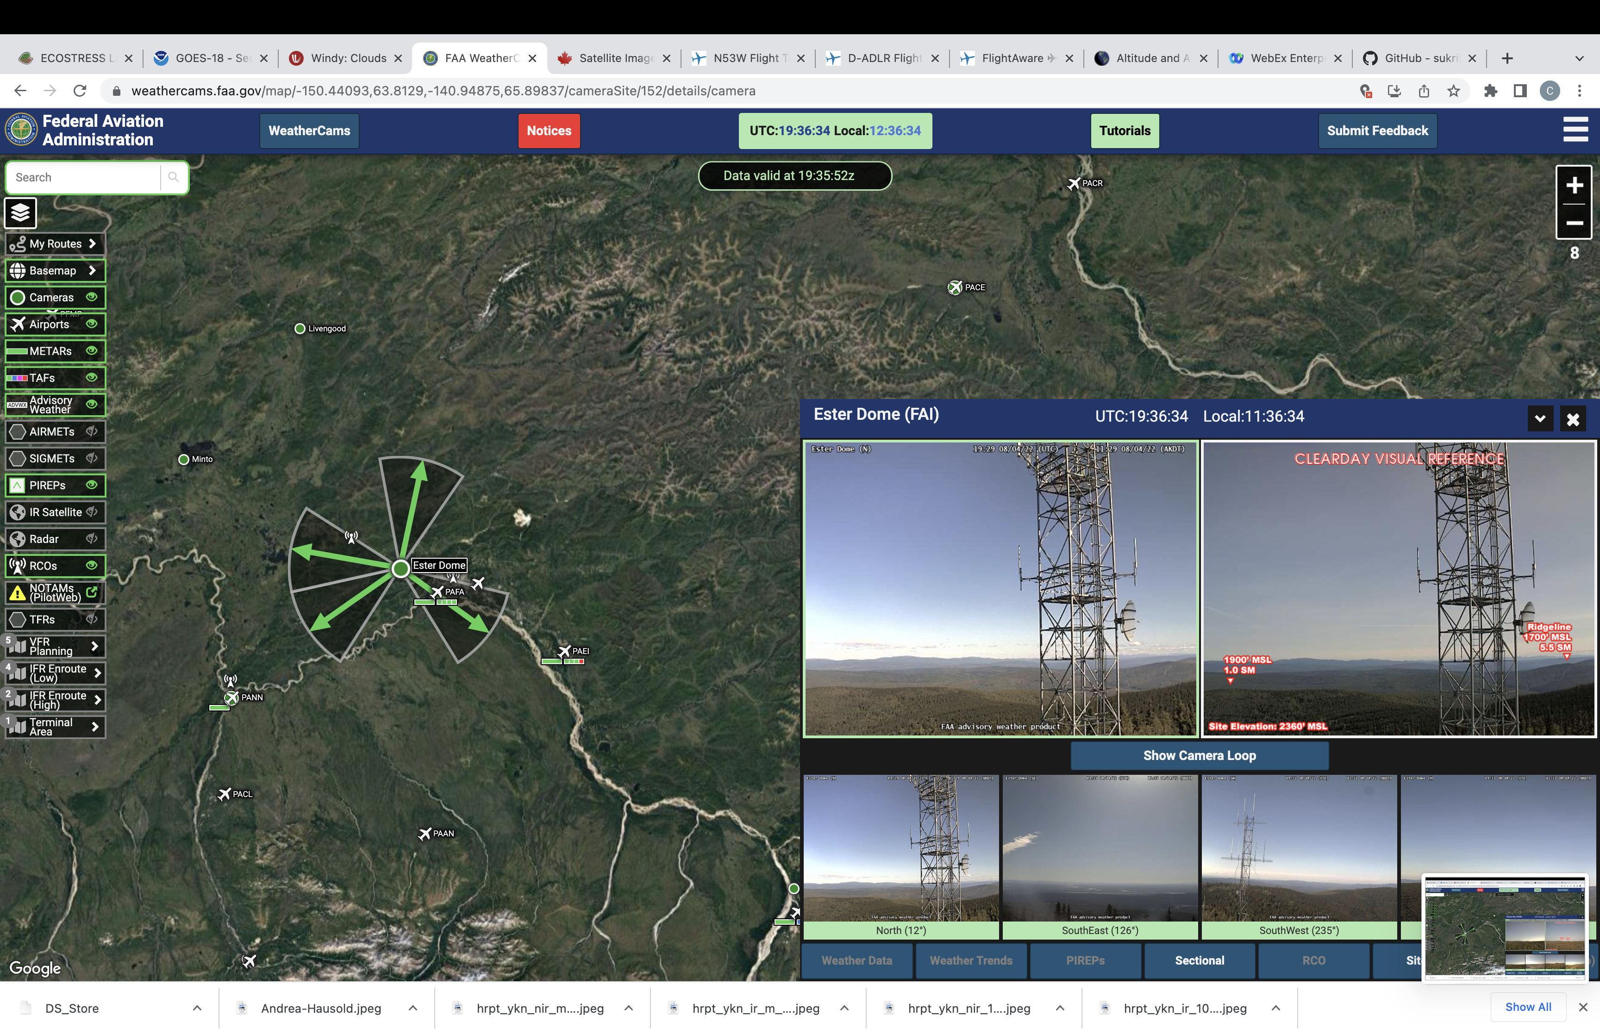
4 August 2022 (DOY 215) Fairbanks Area #4

Slide 24
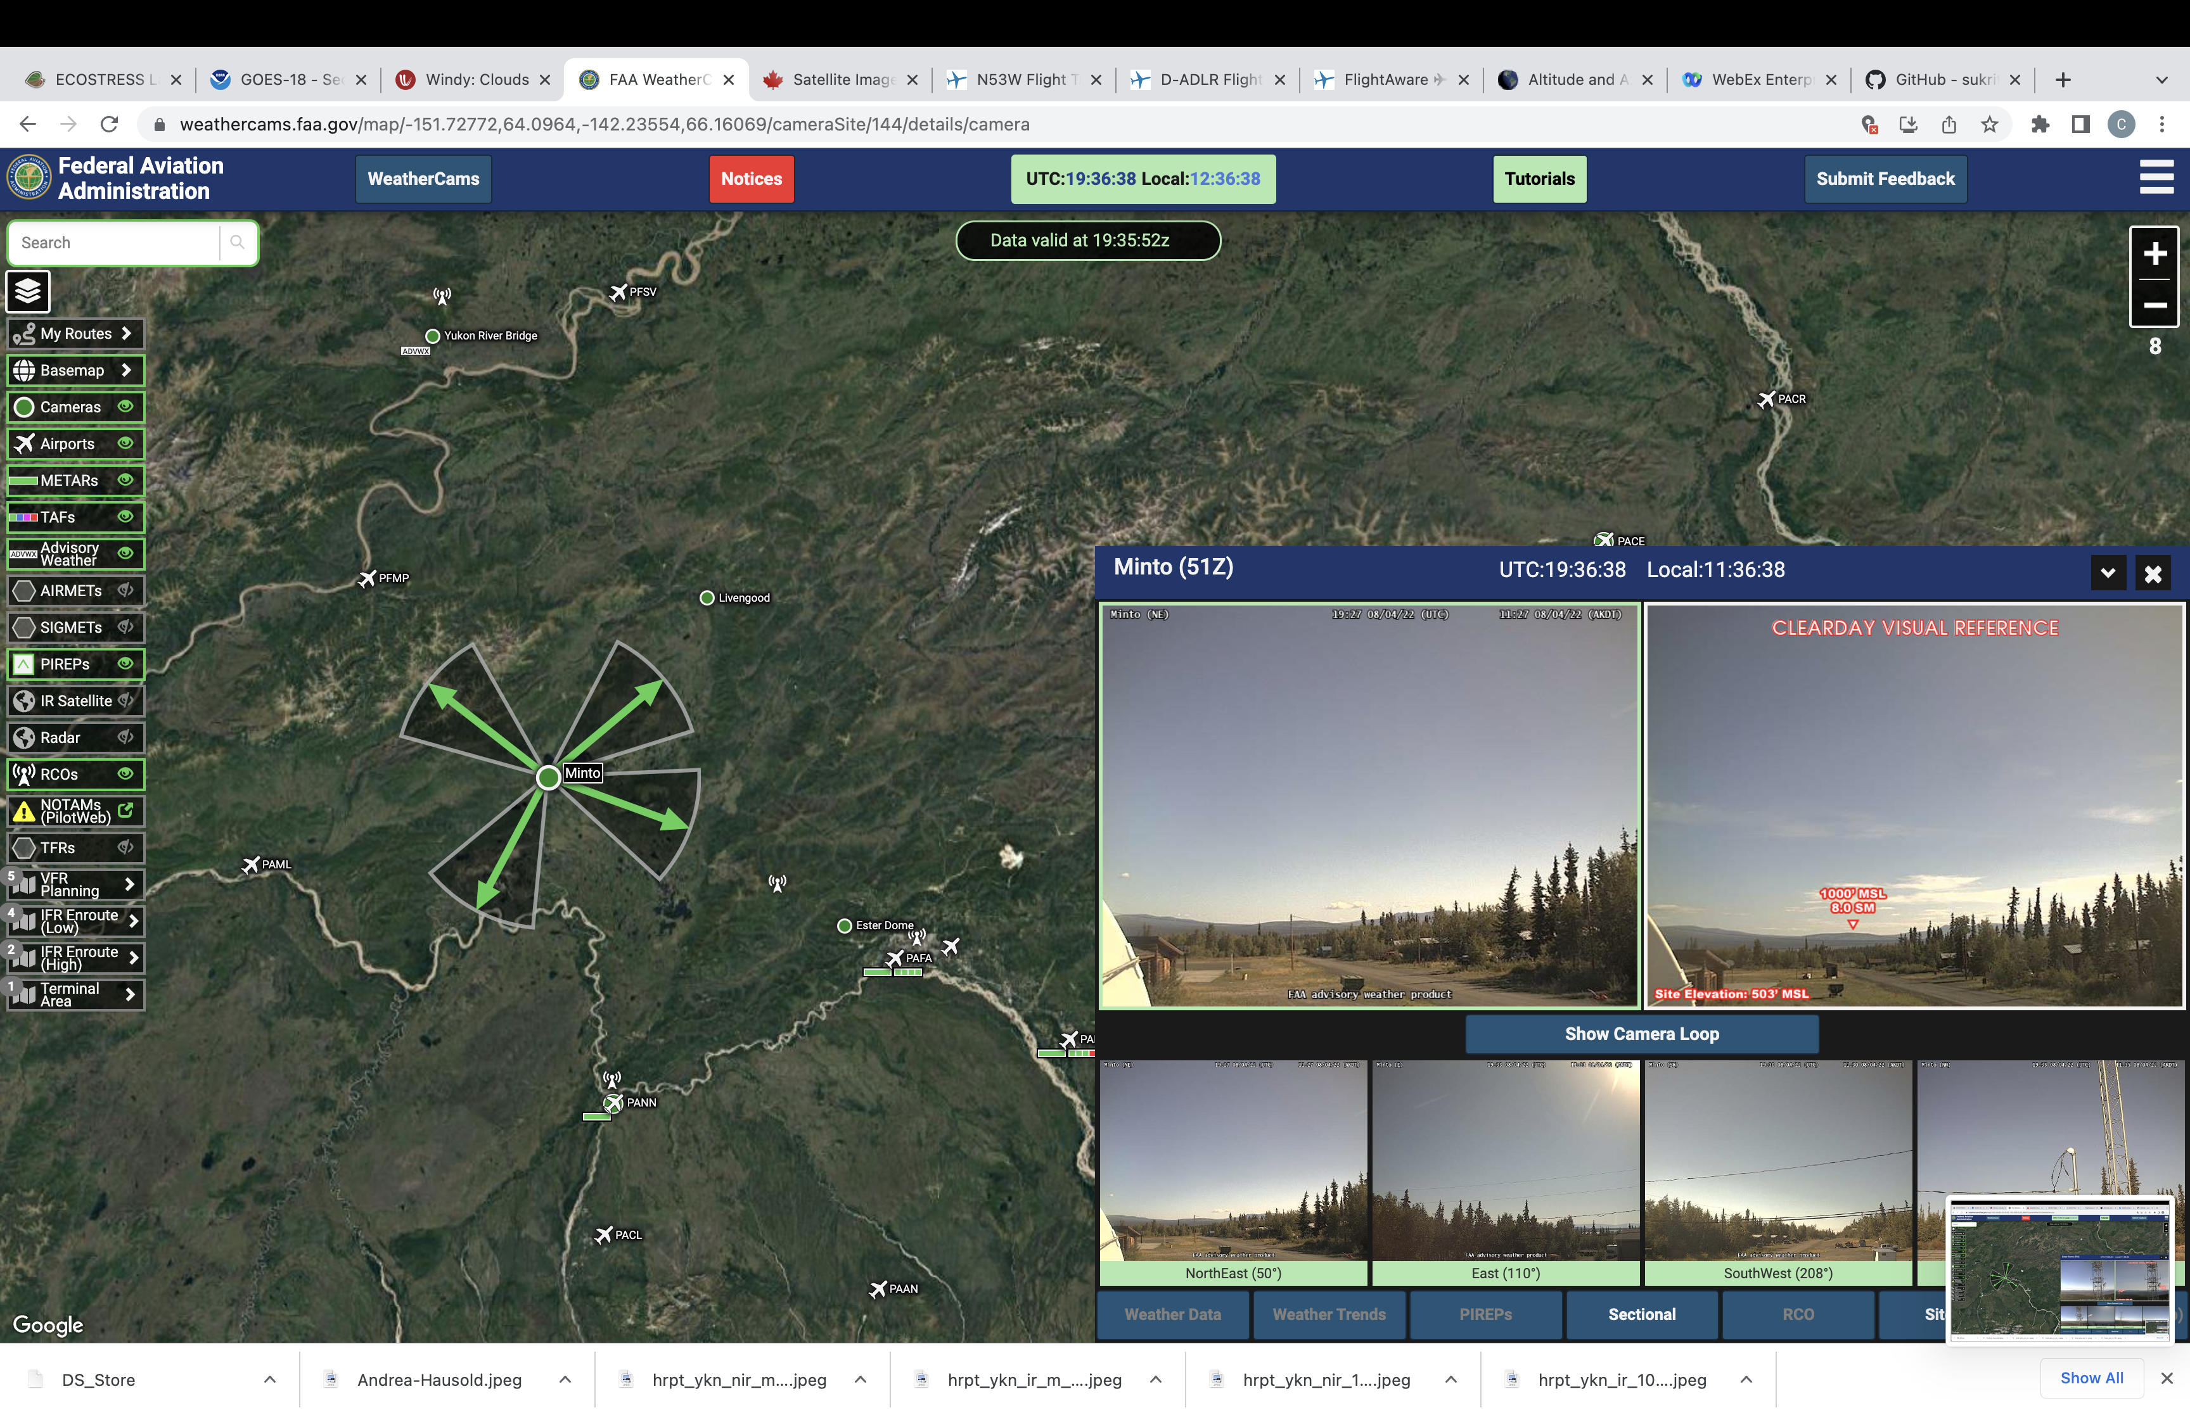
4 August 2022 (DOY 215) Fairbanks Area #4

